Slide 1

Fentanyl
Special Agent Chip Cirillo
DCI/Southeast Enforcement Team

Slide 2
RMHIDTA (Rocky Mountain High Intensity Drug Trafficking Area)
THE ROCKY MOUNTAIN HIDTA REGION-The RMHIDTA was established in 1996 and is responsible for supporting federal, state, local, and tribal law enforcement targeting drug trafficking and money laundering organizations in Colorado, Montana, Utah, and Wyoming.
The RMHIDTA is headquartered in Denver, CO. The RMHIDTA designated areas include 30 counties across the four states (see map):
Colorado: Adams, Arapahoe, Denver, Douglas, Eagle, El Paso, Garfield, Jefferson, La Plata, Larimer, Mesa, Pueblo, and Weld
Montana: Cascade, Flathead, Gallatin, Lewis & Clark, Missoula, and Yellowstone Utah: Davis, Salt Lake, Utah, Washington, and Weber
Wyoming: Albany, Campbell, Laramie, Natrona, Sweetwater, and Uinta

Slide 3
Drug Task Forces
The RMHIDTA funds 23 drug task forces, four highway criminal interdiction programs, and one fugitive apprehension task force.
These 28 task forces are supported by three administrative divisions: management and coordination, training, and an investigative support center.
There are 11 federal, 15 state, and 110 local agencies directly working with RMHIDTA.

Slide 4
Area of Responsibility
RMHIDTA covers an area of approximately 434,000 square miles. By comparison, states running north to south from Maine to South Carolina and east to west from New Jersey to Kentucky would all fit within the RMHIDTA region.

Slide 5
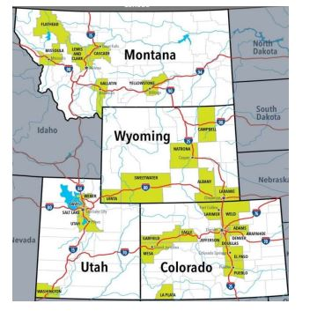

Slide 6
Population
The total population of the entire region is approximately 10.83 million, with three major metropolitan areas being Denver Metro (population roughly 3 million), Colorado Springs Metro (population roughly 755,000) and Salt Lake City Metro (population roughly 1.26 million).
Billings is the largest city in Montana (population roughly 110,000) and Cheyenne is the largest in Wyoming (population roughly 64,000).

Slide 7
Most significant threat.
Although China has been identified as a source for fentanyl and the materials to make it, most of what is seen in the Rocky Mountain region is being sourced from drug trafficking organizations located in Mexico, transporting the drug across the Southwest border
The amount of individual dosage units of fentanyl seized in 2021 skyrocketed to 622,507 compared to the 95 dosage units seized in 2017. Pounds of fentanyl seized increased 876% from 2017 to 2021

Slide 8
Seizures
Seizures of fentanyl dosage units were relatively low in 2017 but increased by nearly 6,553 times in 2021.
Pounds of fentanyl seized also increased nearly 877% from 2017 to 2021.
The amount of fentanyl seized by dosage unit and pounds were determined to be very high based on an average of 159,673 dosage units and 112 pounds seized from 2017 to 2021.

Slide 9
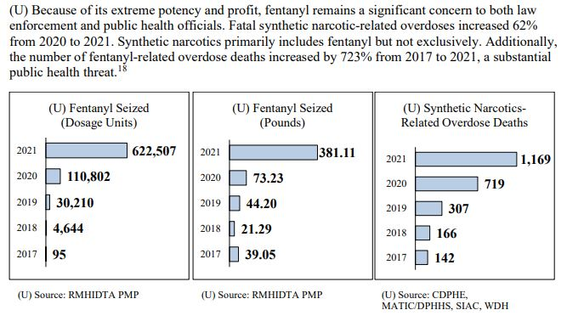

Slide 10
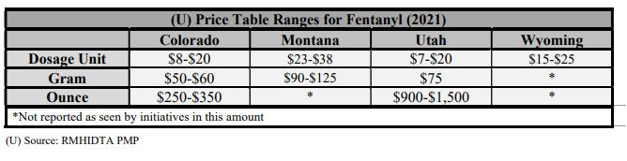
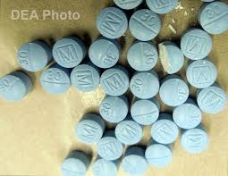
Prices

Slide 11
Crime
The largest change from 2016 to 2020 was in Montana where violent crime increased by 19% and property crime decreased by 13%.
Additionally, property crime decreased in Utah by 13% while it increased by 9% in Colorado.
Violent crime increased in Colorado and Utah from 2016 to 2020 by 9% and 6% respectively.
In Wyoming, incidents based on NIBRS reporting was only available in 2020, so comparisons are not available.

Slide 12
Violent Crime
The violent crime rate increased significantly in Colorado (344 in 2016 to 423 in 2020) and Montana (374 in 2016 to 470 in 2020), slightly increased in Utah (243 in 2016 to 261 in 2020) and decreased in Wyoming (245 in 2016 to 234 in 2020).
Crime rates are based on 100,00 incidents per person. The violent crime rate in 2020 in Colorado (423) and Montana (470) were higher than the United States rate (399).

Slide 13
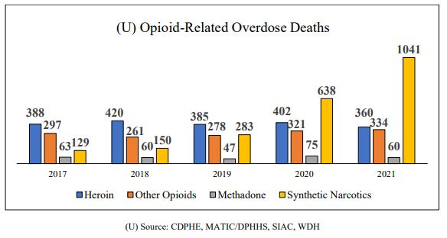
DeathS

Slide 14
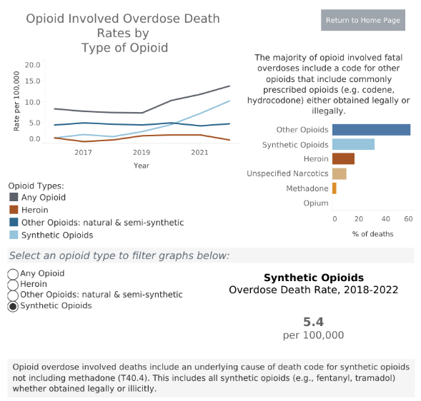
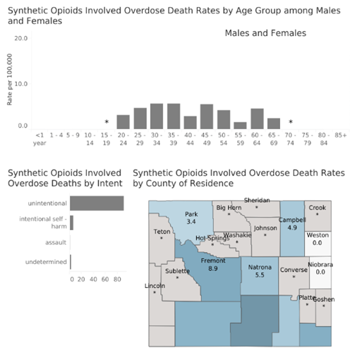
Drug Overdose Dashboard-Wyoming Department of Health

Slide 15
Wyoming Overdoses for the moNTh of May, 2023
Non-fatal overdoses: 137, compared to 130 last month.
Total Naloxone use reported by EMS: 24
Top 5 Hot spot counties: Laramie (33), Natrona (26), Sweetwater (16), Fremont (12), Albany (12)

Slide 16
Year to Date Fatal Overdoses:
Data provided by Vital Statistics shows a YTD total of 55 fatal overdoses in Wyoming since January 1, 2023.
Of the 55 reported deaths during this time, 21 involved “other” or multiple drug toxicity;
15 involved fentanyl or a multiple drug toxicity including fentanyl;
10 involved methamphetamine;
2 involved prescription drugs;
1 involved cocaine and 1 involved alcohol;
5 were unknown, as of yet.

Slide 17
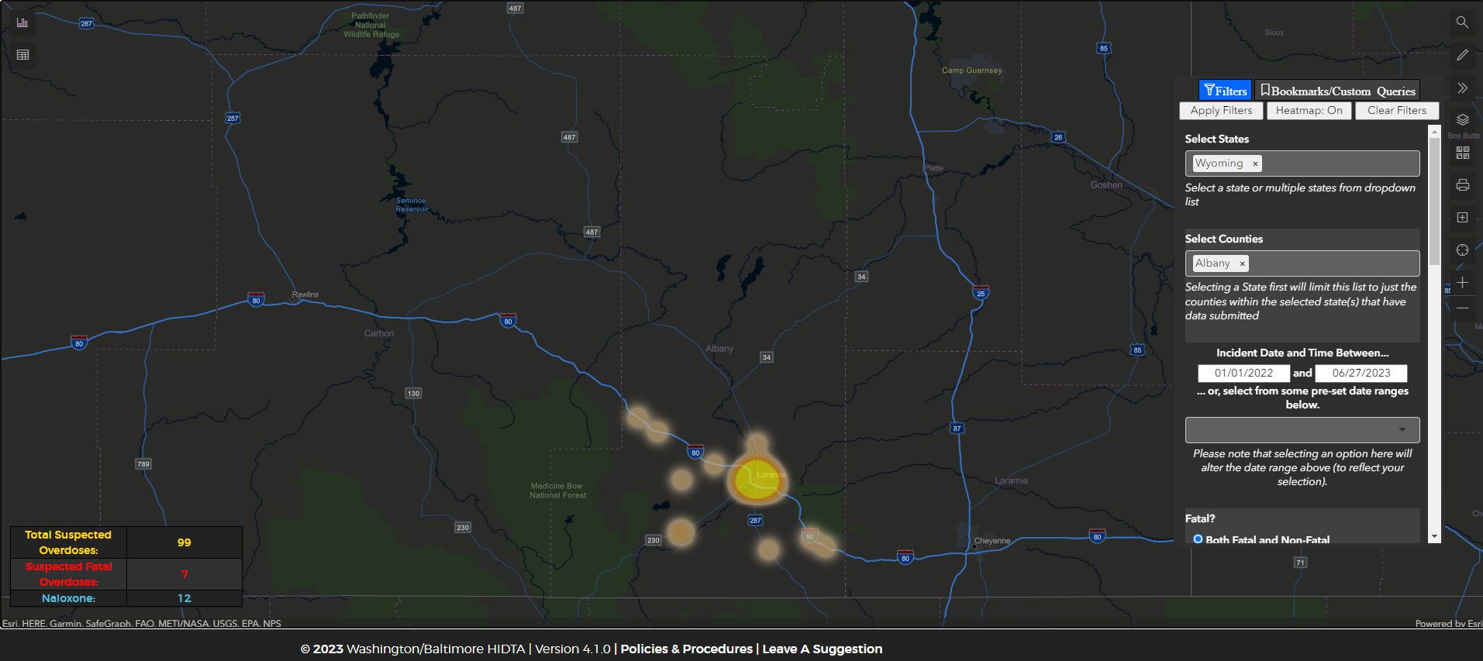

Slide 18
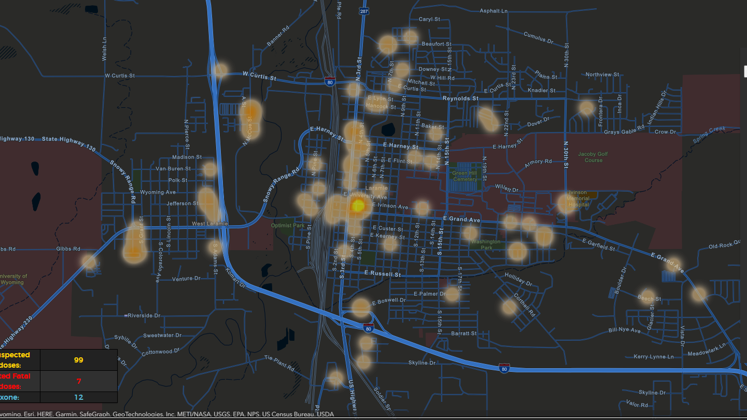

Slide 19
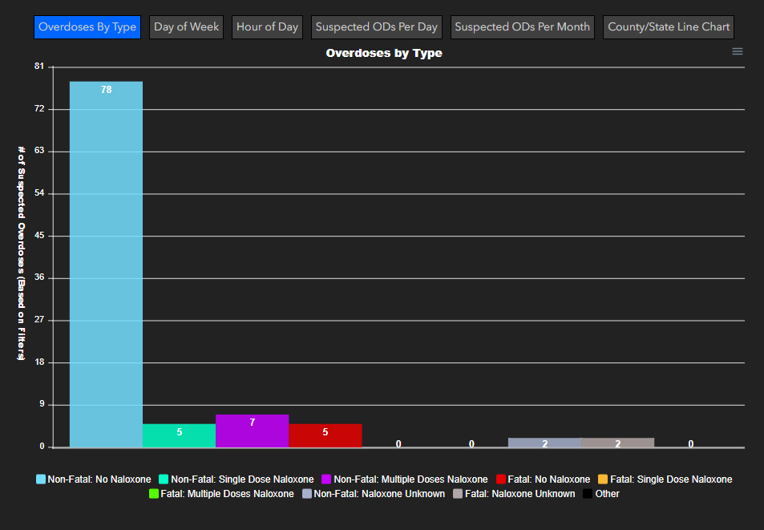

Slide 20
Wyoming Department of Health
Data entered into ODMAP collected from Wyoming Department of Health, EMS and Vital Statistics. Qualitative analysis of the suspected drug is not conducted by EMS.
Patients are evaluated based on symptoms. It is important to understand that heroin, oxycodone, and fentanyl can manifest similar symptoms to first responders in the field. Stabilizing and transporting the patient to the emergency department is priority for EMS.
Fatal data for the month should not be considered complete until all toxicology is received by county coroners, then reported to Vital Statistics. This can take several weeks. EMS provides data on fatal overdoses within 24 hours, however the drug or drugs that caused the fatality are only suspected- not qualified by laboratory analysis.
Data provided under data use agreement with Wyoming Department of Health, Vital Statistics and Rules for EMS Reporting Requirements, Ch. 4-4-h-iii.

Slide 21
Sources:
Drug Overdose Dashboard - Wyoming Department of Health
Wyoming Department of Health
EMS and Vital Statistics

Slide 22

Questions?

